Slide 1
Generating Select Synthetic Data
Lin Li
WESTAT @ JSM 2024 — Statistics and Data Science: Informing Policy and Countering Misinformation
The views presented are those of the author(s) and do not represent the views of any Government agency/department or Westat.

Slide 2
Agenda
Longitudinal Synthetic Data for the Survey of Doctorate Recipients (SDR)
Background
Challenges
Approach

Slide 3
Survey of Doctorate Recipients (SDR)
Biennial survey of U.S. research doctorate holders in science, engineering, and health (SEH) fields conducted since 1973
Conducted by the National Center for Science and Engineering Statistics, with sponsorship from the National Institutes of Health
Provides demographic, education, and career history information
Sample design
Stratified sample with unequal sampling rates across strata
Maintains continuing cohorts from the year of degree award until age 76
Replenishes sample with newly awarded PhDs in every cycle

Slide 4
Current Microdata Availability | Tiered Access
Generating cross-sectional data and longitudinal data
 | Cross-Sectional SDR (CS-SDR) |  | Longitudinal SDR (L-SDR)
 | Restricted-Use File (RUF) | Public-Use File (PUF) | RUF | PUF
Available? | Yes | Yes | Yes | Not yet

Slide 5
Path to Public-Use Longitudinal Microdata | Challenges
Balancing two competing objectives
Reducing disclosure risk
Maintaining data utility
Longitudinal SDR PUF → increased risk
Some protection by data coarsening/suppression, imputation, etc.
Inherent risk due to longitudinal data
An L-SDR PUF will increase disclosure risks of CS-SDR PUFs, and vice versa
Majority of L-SDR cases can be uniquely and correctly matched to a record on CS-SDR PUFs using demographic and other survey variables

Slide 6
Path to Public-Use Longitudinal Microdata | Solution
Solution | Select synthetic data
Synthesize a subset of variables for a subset of randomly selected cases, targeting highly identifying variables of high-risk cases
Re-rake weights to align with population totals of key domains
Further challenges with synthetic data
Survey data with weights, data dependency (e.g., longitudinal trend, skip patterns), and various types of variables
Variance estimation to account for data synthesis

Slide 7
Experimental Factors
Degree of synthesis
Overall data synthesis rates of 83%, 50%, and 15%
Varying synthesis rates by risk strata
Synthesis approach options
Imputation (already in place for L-SDR RUF)
Sequential model-assisted constrained hot-deck imputation (MACH)
R package | synthpop, using classification and regression trees (CART)

Slide 8
Risk-Utility Trade-Off
Quantifying risk reduction
Comparing percentage of records accurately (uniquely and correctly) matched to their corresponding records in CS-SDR PUFs before and after data synthesis
Utility preservation
Assessing the proximity between original and synthetic data
Variables by themselves
Estimates
Associations (e.g., longitudinal relationship)
Summarizing several distance measures by computing the average distance measure relative to that under the scenario of imputation approach with 15% data synthesis

Slide 9
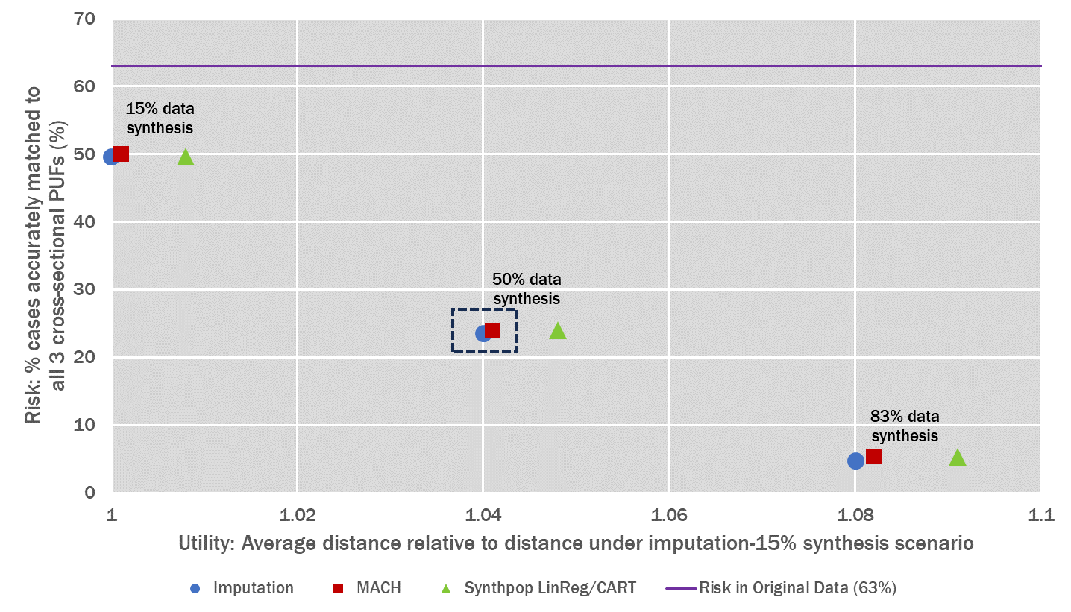
Risk-Utility Trade-Off (continued)

Slide 10
Findings
Degree of select data synthesis
As the data synthesis rate increases, there is a greater reduction in risk, but it also entails a more significant compromise in utility
Selected 50% due to considerable risk reduction without substantial compromise in utility
Select data synthesis approach
MACH and imputation approaches presented similar performance
Selected MACH for its features, including the ability to handle skip patterns and safeguards to uphold relationships

Slide 11
Selected Data Synthesis Approach
MACH process
Fit parametric model
Form groups on predicted values
Using the groups and other boundary variables to form hot-deck cells
Draw donors within cells
Westat developed the original algorithm for the U.S. Census Bureau for perturbing American Community Survey data for the Census Transportation Planning Products
Handles skip patterns and includes safeguards to respect critical relationships
Can generate select synthetic data as well as partial synthetic data

Slide 12
Thank you
For more information, please contact:
linli@westat.com
westat.com
Photos are for illustrative purposes only. All persons depicted, unless otherwise stated, are models.

